Slide 1
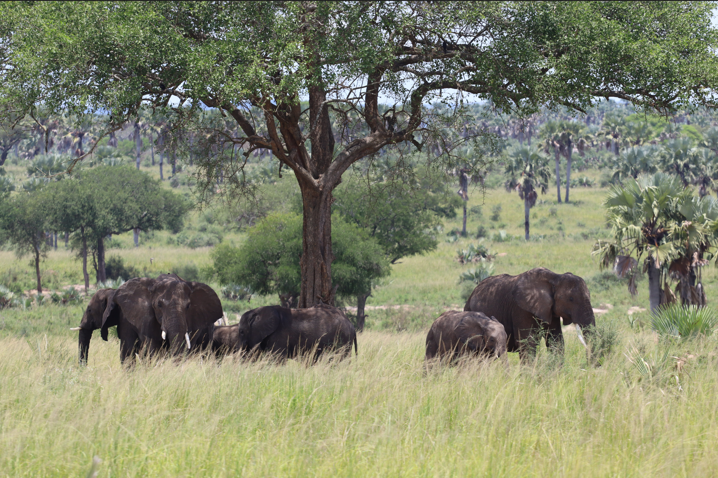
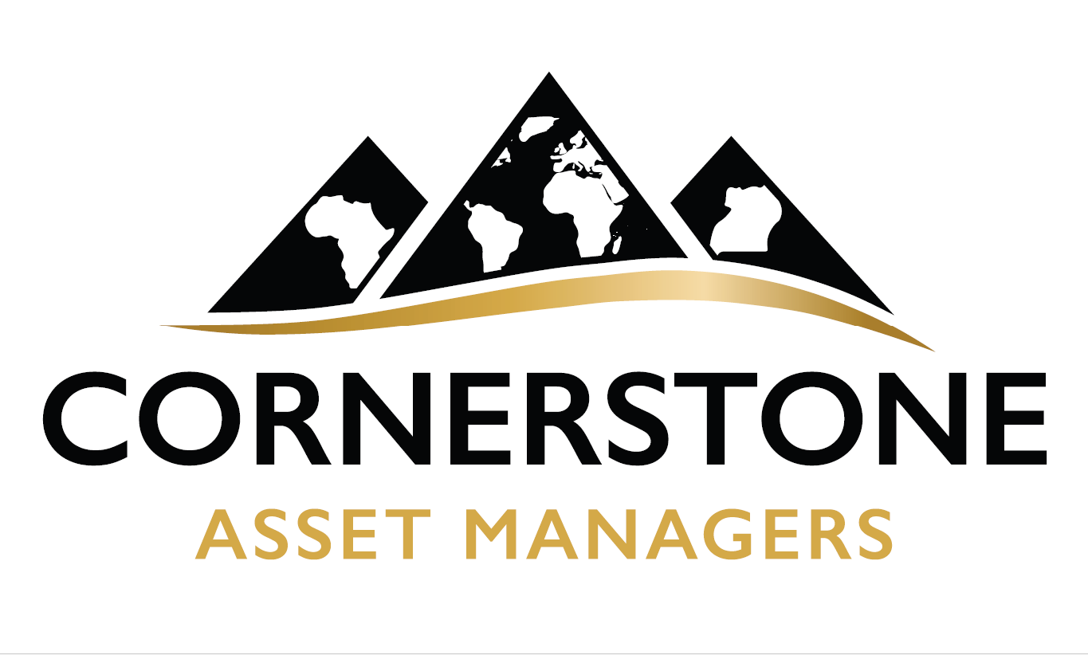

Slide 2
WHO IS CORNERSTONE ASSET MANAGERS LIMITED
Cornerstone Asset Managers Limited is an Investment Management Company Incorporated in Uganda and is currently pursuing a Fund Management License under both the Capital Markets Authority Uganda(CMA) and the Uganda Retirement Benefits Regulatory Authority(UBRA)
Our Vision is to pursue the African Renaissance by enabling more people experience financial well-being.
Cornerstone Asset Managers Limited is a 80% owned by Stewards Financial Holdings which is a Uganda incorporated and 100% owned by Ugandan Locals. The remaining 20% Ownership is held by internal staff under the staff ownership plan.
Cornerstone Asset Managers is adequately capitalized with a Capital Base above Ushs. 1,500,000,000.

Slide 3
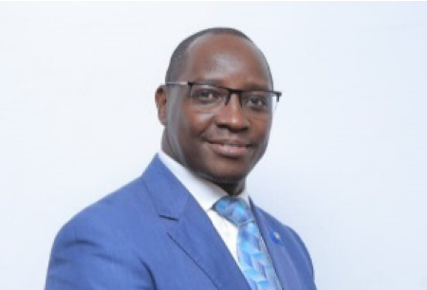
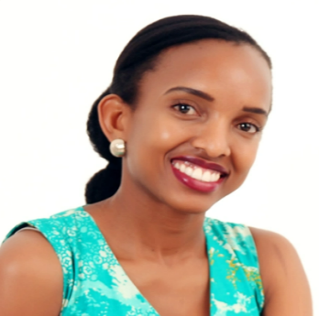
WHO IS CORNERSTONE ASSET MANAGERS LIMITED--Our Team-The Board
Board Chairman- Michael Opira
Michael a seasoned banker with a solid track record at business transformation with a key emphasis around systems and technology.
Michael is currently the Chief Operations Officer at Housing Finance Bank a role he has held since 2021 leading transformation in the operations leading to improved profitability as seen in 2023 Annual Performance.
Michael will be tasked with leading the company strategy from a governance point of view and will be critical to Cornerstone’s performance in the years ahead.
Director- Martha Okweyo Agaba
Marth is a highly experienced and accomplished Senior Architect, with over a decade of expertise in architectural design, project management, and stakeholder engagement.
Martha's career includes significant roles at prestigious firms like Dar Al-Handasah Consultants, UNOPS/MONUSCO, and Symbion (U) Ltd. She has been instrumental in major projects such as the upgrading and expansion of Entebbe International Airport and the construction of key facilities at the Entebbe Support Base.

Slide 4
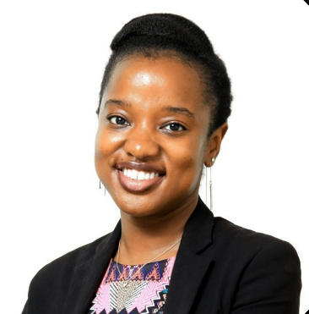
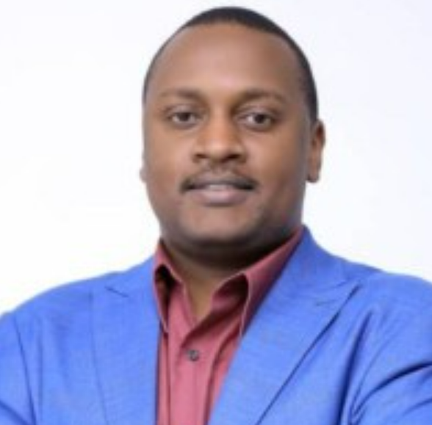
WHO IS CORNERSTONE ASSET MANAGERS LIMITED--Our Team-The Board
Director- Christina Lunkuse
Christina is a seasoned professional with a background in providing strategy and investment advisory services to businesses. She uses her business acumen and hands-on experience to understand how businesses operate to make money, and to proactively anticipate, navigate and leverage internal and external trends that could
impact the vision and operations of a company.
She leverages a wealth of experience in transaction advisory, fund management and business capacity building to support entrepreneurs to grow sustainable businesses a seasoned banker with a solid track record at business transformation with a key emphasis around systems and technology.
Managing Director- Simon Mwebaze, CFA
Simon is an investment professional with a strong passion towards enabling individuals and institutions achieve their financial goals and well being. With over 15years actively managing portfolios and asset management companies, Simon has delivered a consistent record enabling many investors across Uganda and the world over achieve their investment goals.
Simon most recently has served as the Managing Director for Old Mutual Investment Group Uganda leading a business transformation and building the largest unit trust fund in East Africa with Assets Under Management of USD 552m as of 20th May 2024. In addition, Simon is a Director at the Uganda Securities Exchange(USE) representing Stock Brokers, He also chairs the Finance, Human Capital and Administration board Committee the Exchange. Simon is a member of the CFA Society of East Africa and also Fund Managers Association of Uganda. He is also the Vice Chairperson and member of the Uganda Bond Market Association.

Slide 5
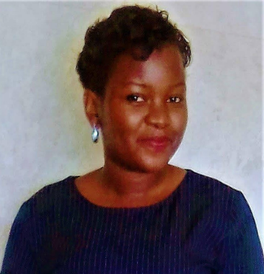
WHO IS CORNERSTONE ASSET MANAGERS LIMITED--Our Team-The Staff
Managing Director- Simon Mwebaze, CFA
Simon is an investment professional with a strong passion towards enabling individuals and institutions achieve their financial goals and well being. With over 15years actively managing portfolios and asset management companies, Simon has delivered a consistent record enabling many investors across Uganda and the world over achieve their investment goals.
Simon most recently has served as the Managing Director for Old Mutual Investment Group Uganda leading a business transformation and building the largest unit trust fund in East Africa with Assets Under Management of USD 552m as of 20th May 2024. In addition, Simon is a Director at the Uganda Securities Exchange(USE) representing Stock Brokers, He also chairs the Finance, Human Capital and Administration board Committee the Exchange. Simon is a member of the CFA Society of East Africa and also Fund Managers Association of Uganda. He is also the Vice Chairperson and member of the Uganda Bond Market Association.
Risk Specialist- Ketra Birungi
Ketra is a seasoned Risk and Compliance professional from Uganda with extensive experience in data analysis, risk assessment, and conflict management. She holds a Bachelor of Science in Quantitative Economics from Makerere University and is currently pursuing a Master's in Business Administration from the University of East London, along with a Diploma in Risk Management from the Institute of Risk Management, UK.
Ketra has most recently been serving as the Risk and Compliance Lead at WAVE Transfer Limited, where she oversees regulatory compliance, fraud prevention, and risk management strategies. With a strong background in audit, compliance, and team leadership, she has held significant roles at Action Against Hunger USA and UAP Old Mutual Uganda, contributing to robust risk management frameworks and business continuity plans.

Slide 6
Our Services

Slide 7
Private Wealth Management
Your wealth deserves more than a one-size-fits-all approach. At Cornerstone, we offer an exclusive wealth management experience designed to meet the unique needs of affluent clients.
Our Wealth Management Solutions Include:
Tailored Investment Strategies: Crafted to align with your personal goals and lifestyle aspirations.
Portfolio Optimization: Striking the perfect balance between risk and return.
Estate and Legacy Planning: Securing your wealth for future generations.
Tax-Efficient Wealth Structuring: Maximizing returns while preserving capital.
We don’t just manage your wealth—we curate an experience of financial empowerment, helping you achieve unparalleled financial success and security.

Slide 8
Our Unit Trust Funds
Gain access to a world of opportunity with our expertly managed Unit Trust Funds, designed to offer both stability and growth in local and international currencies.
Our Distinguished Funds:
Uganda Shilling Income Fund: An ideal parking place for conservative investors seeking consistent returns in Uganda Shillings. Designed for those who prioritize security without compromising on yield.
USD Income Fund: The ideal choice for discerning investors seeking exposure to US Dollar-denominated assets, offering a hedge against currency volatility while unlocking global investment potential.
Each fund is managed with meticulous care, leveraging market insights and robust risk management to deliver optimal performance for our clients.

Slide 9
Our Unit Trust Funds
Fund Name | Cornerstone Uganda Shilling Income Fund
Fund Structure | The Fund is interest bearing with a T+1 max for redemption settlements and unit creation.
Fund Risk Rating | Low Risk
Underlying Fund Asset allocation | Interest bearing with stronger appetite to Tbonds and Tbills, Fixed deposits, Call accounts and cash.
Underlying Income Fund Counter Parties | Custodian and Corporate Trustee- KCB Bank Fund and Unit Trust manager- Cornerstone Fund Auditors- BDO East Africa
Expense Ration | 3% p.a management Fee on the Fund deducted off the investor return
Investment Performance | 91 day Tbill+1% as performance benchmark
Minimum Investment | Ushs 100,000 initial and top ups of UGX 10,000

Slide 10
Our Unit Trust Funds
Fund Name | Cornerstone United States Dollar Income Fund
Fund Structure | The Fund is interest bearing with a T+2 max for redemption settlements and unit creation.
Fund Risk Rating | Low Risk
Underlying Fund Asset allocation | Interest bearing with stronger appetite to Soverign and Corporate bonds of Investment grade,, Fixed deposits, Call accounts and cash, structured investments.
Underlying Income Fund Counter Parties | Custodian and Corporate Trustee- KCB Bank Fund and Unit Trust manager- Cornerstone Fund Auditors- BDO East Africa
Expense Ration | 1.5% p.a management Fee on the Fund deducted off the investor return
Investment Performance | SOFR+
Minimum Investment | USD 500 initial investment and top ups of USD 50

Slide 11
Pension and Retirement Funds
Securing your future has never been more important—or more effortless. Our tailored pension solutions are designed to ensure a dignified and prosperous retirement for individuals and institutions alike.
Our Pension and retirement Solutions Include:
Corporate Pension Scheme Design and Management: Custom-crafted plans that align with your organization’s goals and employee needs.
Individual Retirement Accounts: Empowering individuals to take control of their retirement journey.
Investment Strategies for Retirement Growth: Focusing on capital preservation, steady income, and sustainable growth.
Comprehensive Performance Monitoring: Ensuring your retirement plan remains on track to meet your future lifestyle aspirations.
With Cornerstone, your retirement is not just secured—it is elevated.

Slide 12
So Why Us
Unwavering Integrity:
Licensed and regulated by the Capital Markets Authority of Uganda, we operate with transparency, accountability, and a commitment to safeguarding your wealth.
Expertise Redefined:
Our team of elite financial advisors and investment professionals brings decades of experience and a proven track record of delivering superior financial outcomes.
A Bespoke Experience:
Every client is unique, and so is every solution. We provide personalized, white-glove service that aligns with your vision and lifestyle.
Global Perspective, Local Expertise:
Our diversified investment strategies draw on global market insights while remaining attuned to local opportunities, giving you the best of both worlds.
Commitment to Excellence:
At Cornerstone, we redefine success by delivering more than just financial returns. We cultivate lasting relationships built on trust, performance, and a shared vision for the future.

